Slide 1
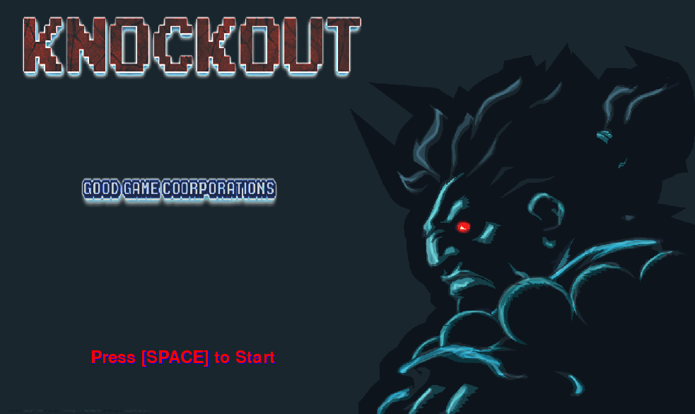
Notes:
Game Company: GoodGame Corporations
Team Members: Joyce Hu, Jose Aranibar, Syed Bazif & Jessica Li
Period 6

Slide 2
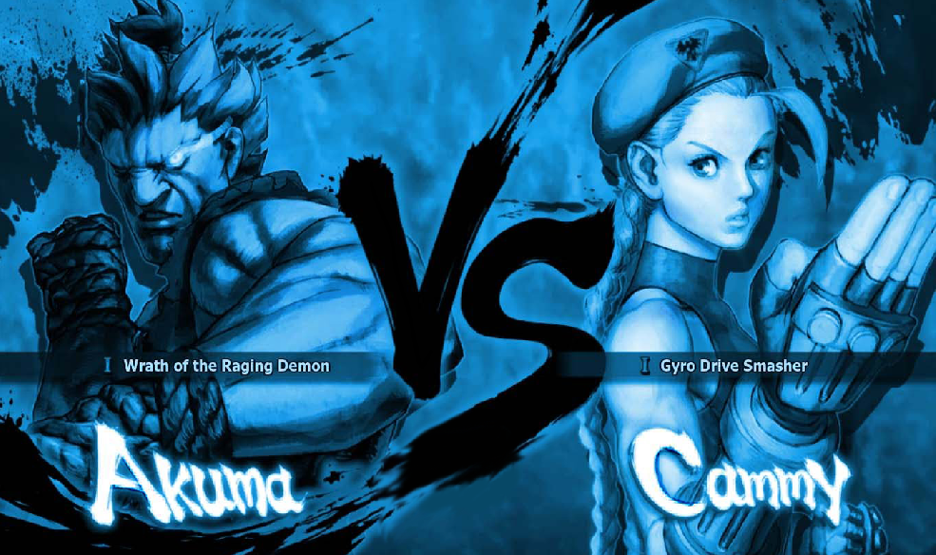
Notes:
The objective of the game is to have two characters fighting each other. It’s going to be a multiplayer game. It is going to consist of one round; the player that is defeated (when the health is at zero), will lose the game. The goal is to win the one round and be the last one standing.

Slide 3
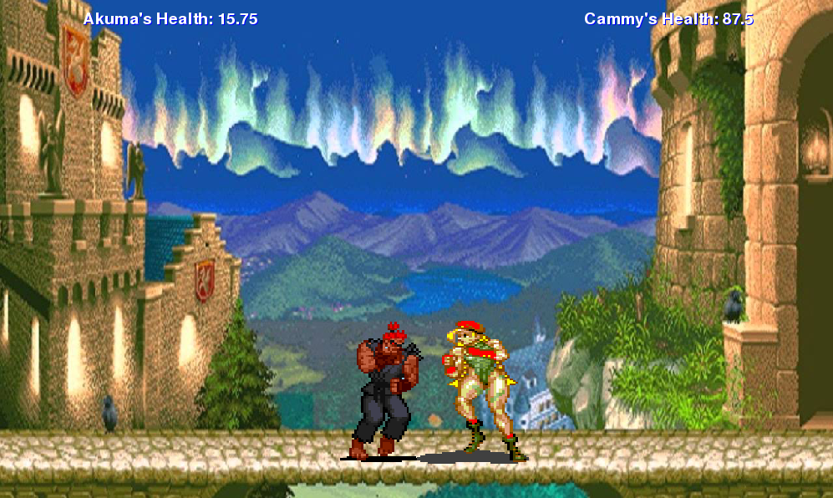
Notes:
Knockout is a fighting game. There would be two fighters engaged in mortal combat consisting of one round.

Slide 4
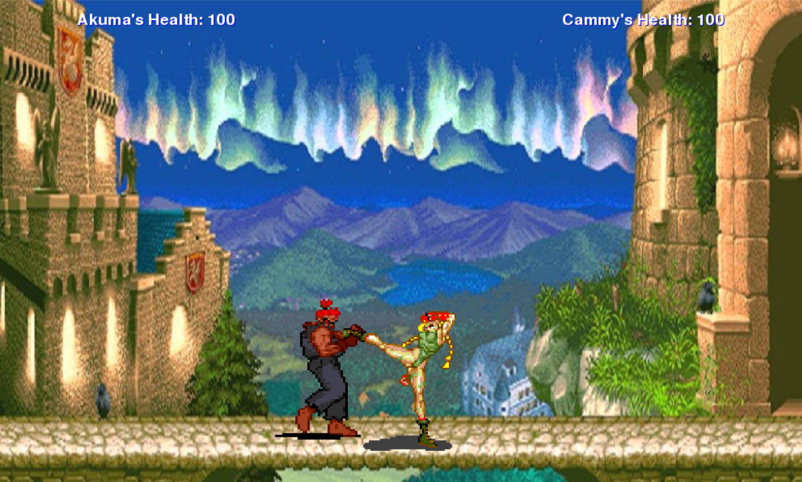
Notes:
The player will interact with Knockout using the mouse and keyboard. The keyboard would be used to control the fighter such as going forwards or backwards, as well as summoning the fighter’s special abilities that the player can use during the round.

Slide 5
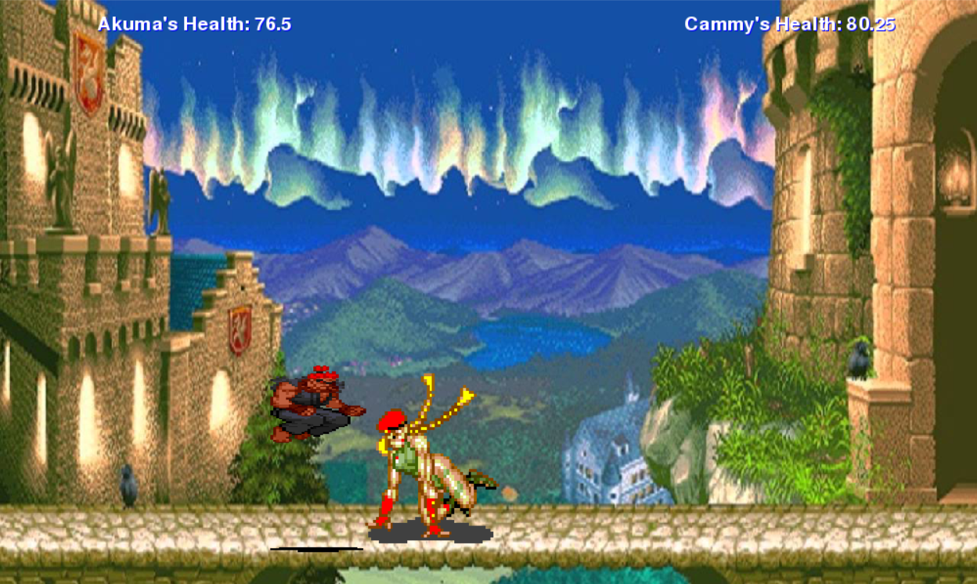
Notes:
The challenges/obstacles is how the player will move their character; will he dodge the kick or will he react too slow? It depends on how the players will interact with their character. Each character will consists of their own special abilities, which will make it more difficult for the player to react and dodge.

Slide 6
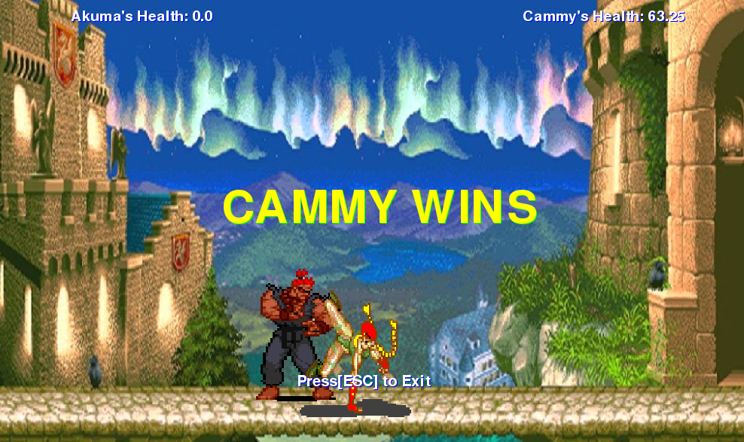
Notes:
The player can win by being the last one standing at the end of round. A round will end when a player loses or reaches a health of zero.

